Slide 1
Development of master curricula for natural disasters risk management in Western Balkan countries
WP6.3 Promotional activity for student enrolment
WP6.4 Promotional activity for trainings
Milan Gocić
University of Niš
Fifth Project Management Committee meeting/ 21st March 2019
Project number: 573806-EPP-1-2016-1-RS-EPPKA2-CBHE-JP
"This project has been funded with support from the European Commission. This publication reflects the views only of the author, and the Commission cannot be held responsible for any use which may be made of the information contained therein"

Slide 2
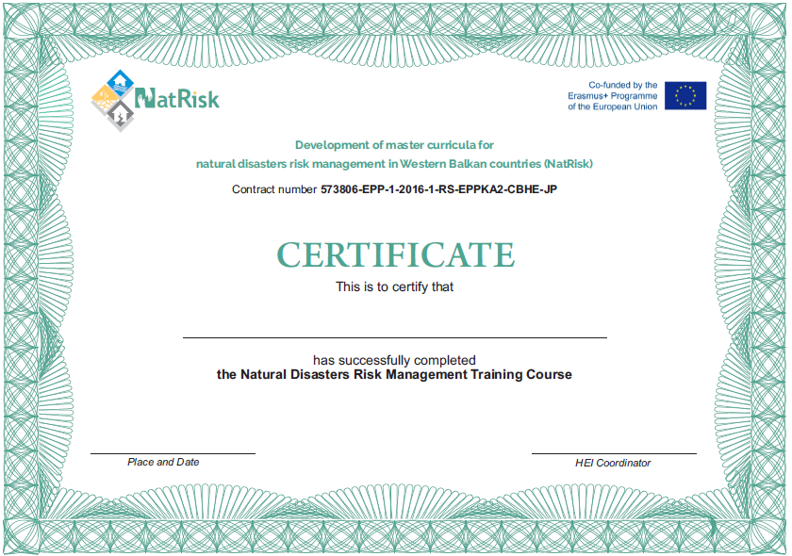
Certificate
Development of master curricula for natural disasters risk management in Western Balkan countries

Slide 3
Leaflet for training
Development of master curricula for natural disasters risk management in Western Balkan countries

Slide 4
Leaflet for training
Development of master curricula for natural disasters risk management in Western Balkan countries

Slide 5
Leaflet for training
Development of master curricula for natural disasters risk management in Western Balkan countries

Slide 6
Leaflet for training
Development of master curricula for natural disasters risk management in Western Balkan countries

Slide 7
Leaflet for master curricula
Development of master curricula for natural disasters risk management in Western Balkan countries

Slide 8
Leaflet for master curricula
Development of master curricula for natural disasters risk management in Western Balkan countries

Slide 9
Brochure for master curricula
Development of master curricula for natural disasters risk management in Western Balkan countries

Slide 10
To do list
Development of master curricula for natural disasters risk management in Western Balkan countries
Each WB HEI should print leaflet for promotion master curricula (5000x) and brochure (20 pages, 500x) in line with the planned budget. UNID, KPU, UBL
Organize info days or meetings with future students in secondary schools and promote master curricula using media (printed, on-line, TV or radio) All WB HEIs
Organize round-tables or meetings with relevant stakeholders (red cross, fire brigades, police, emergency agencies, representatives of municipalities) All WB HEIs
Write report using event form related to training and master curricula promotion All WB HEIs

Slide 11
Development of master curricula for natural disasters risk management in Western Balkan countries
HEI | Leaflet |  | Brochure
 | Designed | Printed | Designed | Printed
UNI
KPU
UPKM
UNSA
UBL
TCASU
UNID

Slide 12
Development of master curricula for natural disasters risk management in Western Balkan countries
Sub-Contrating - Supporting documents
Invoices, subcontracts and bank statements Certified copy

